Slide 1

BART Police Dispatch
Join our team!

Slide 2
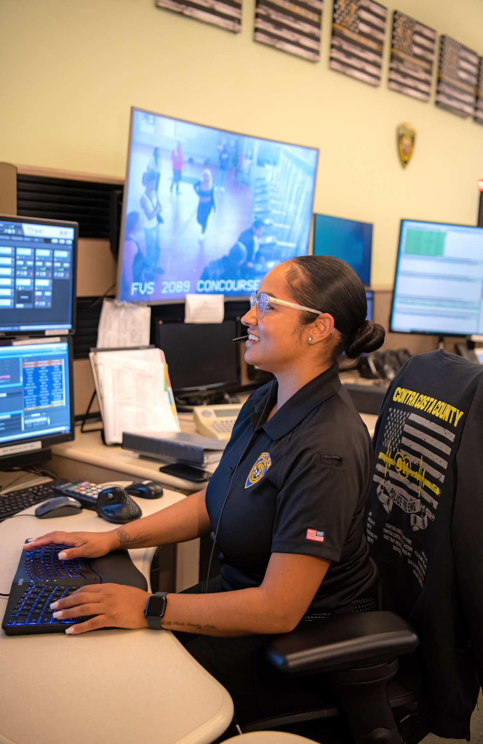
Mission statement:
“The mission of the BART Police Department is to ensure a safe environment within our transit system, reduce crime through a highly visible police presence and proactive enforcement of the law, and to promote public confidence by working in partnership with our stakeholders and the communities we serve.”

Slide 3
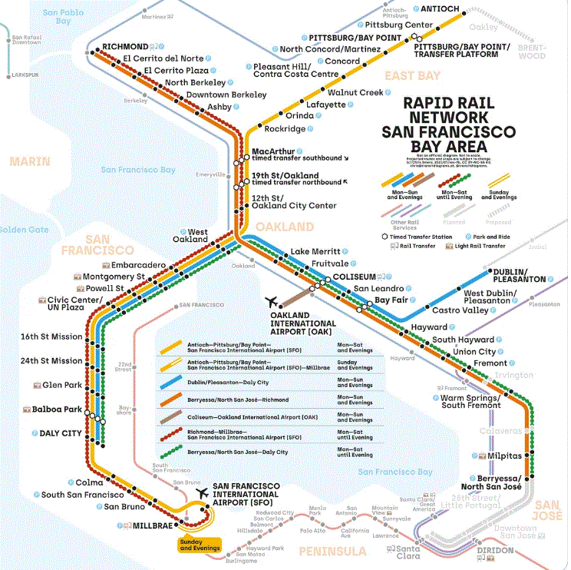
BART Geography
BART trains run in 5 Counties divided into Zones
-Alameda (Zone 1 & 3)
-Contra Costa (Zone 2)
-San Francisco (Zone 4)
-San Mateo (Zone 5)
-Santa Clara (Zone 6)

Slide 4
Salary/Benefits
The police department has numerous benefits that include :
Lifetime medical after 15 years of service, 50% after 10 years of service
Opportunities for double time pay
Longevity Pay (after 20 years of service)
Holiday Conversion Pay
Educational Reimbursement ($4k per fiscal year)
Shift Differential (7% swings, 9.5% graveyard)
Educational Incentive (3% for AA or higher)
Bilingual pay incentive
CTO (5% increase pay)
Premier medical, dental and vision benefits
Uniform Allowance
Free BART transportation for employees and dependents
Salary range $81,409 to $115,652*

Slide 5
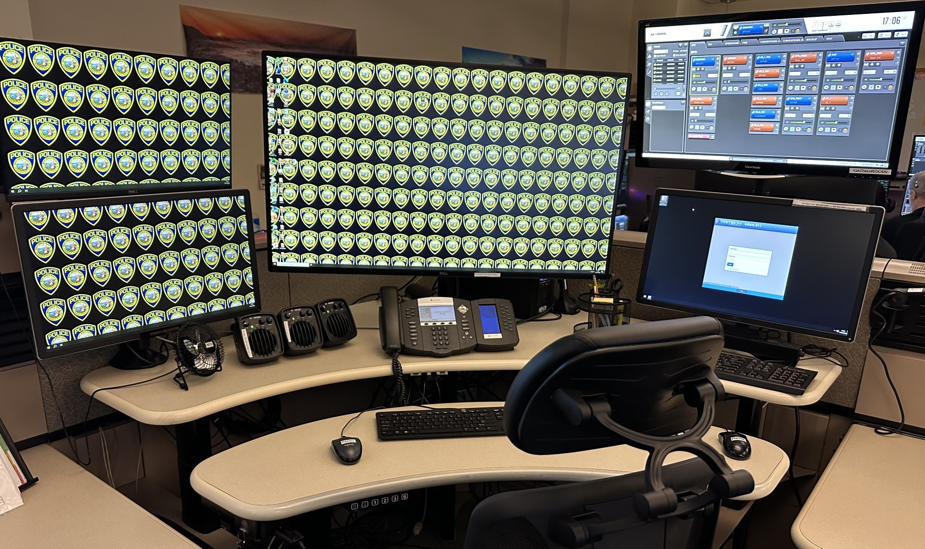
Our Communication Center
14 Dispatchers operate the center 24/7
4/10 & 5/8 schedules available during days, swings and graveyard shifts
Receive emergency and non-emergency calls from the public and BART employees
Communicate with transportation for train related incidents
Dispatch units on a 2-way radio system
Respond to text messages from the BART Watch App
Dispatchers manage day to day administrative tasks
Some dispatchers fulfill other various roles in addition to the duties of a dispatcher such as peer support, union representatives, recruitment, training and leadership

Slide 6
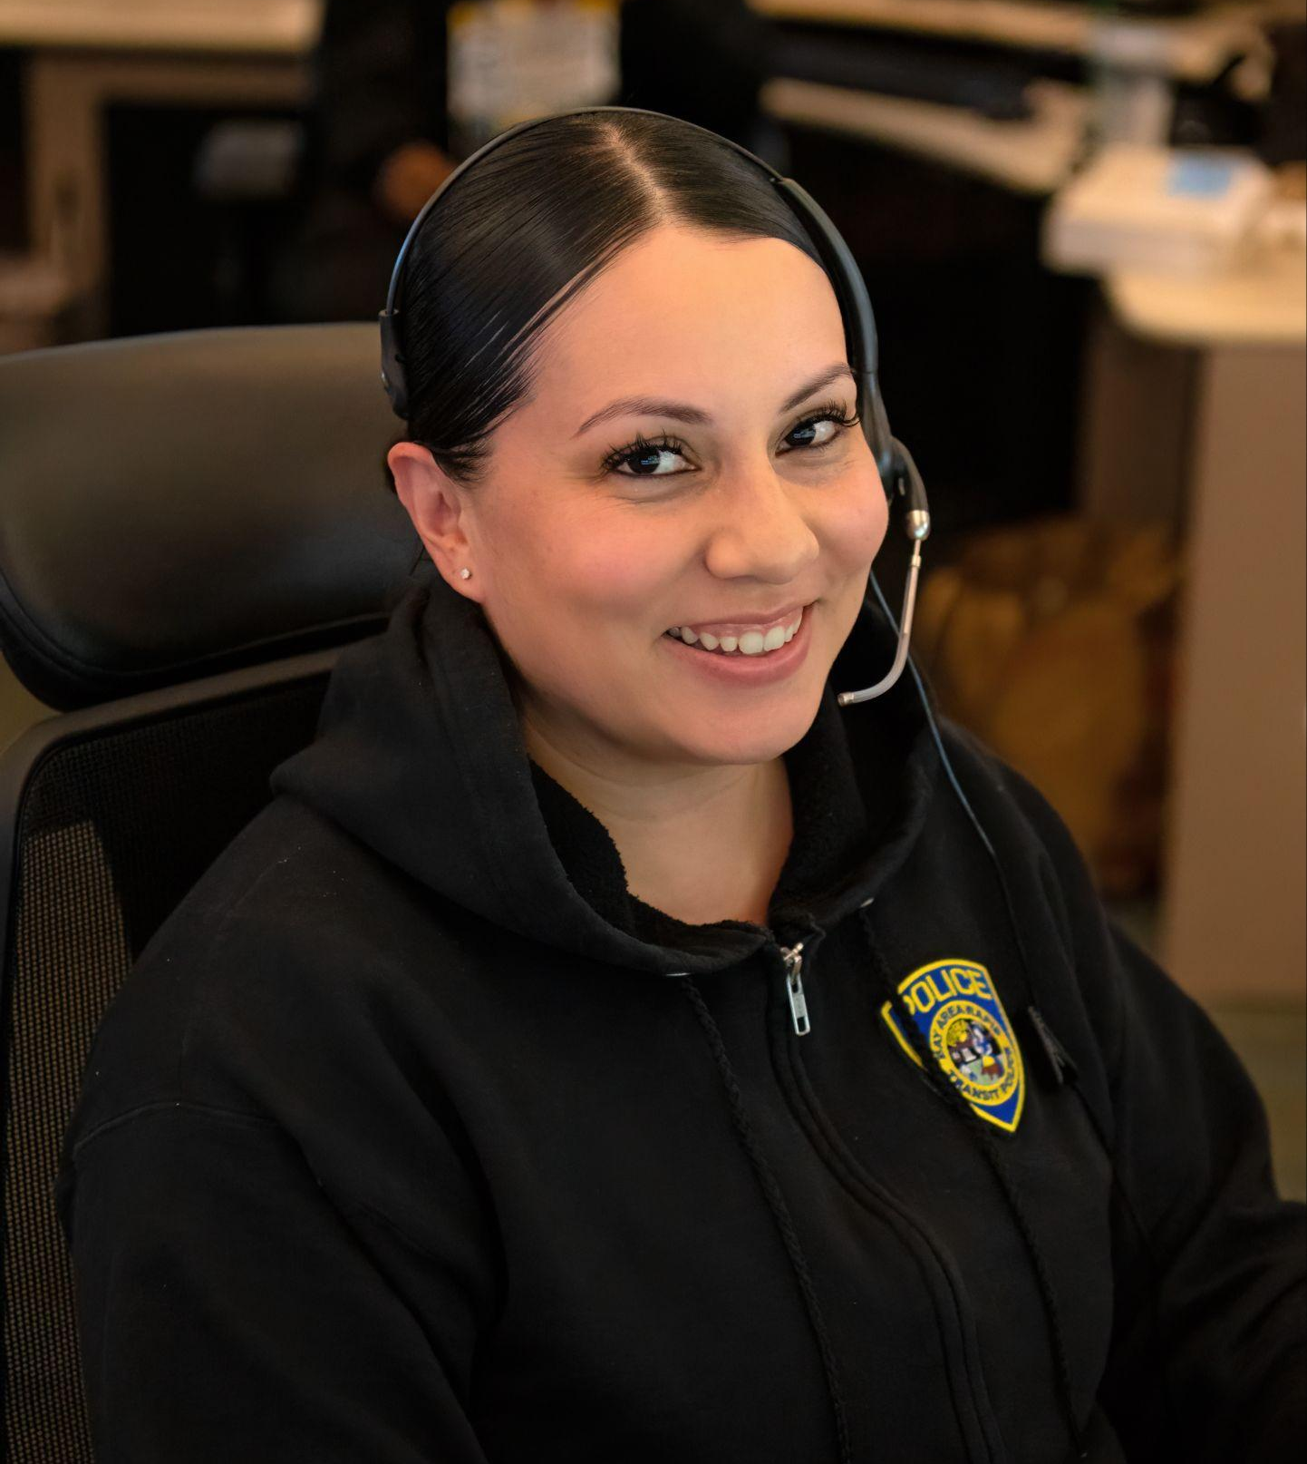
Skills of a BART Police Dispatcher
Customer Service skills
Emotional Control
Technical, typing and Computer literacy
Decision making skills with confidence & good judgement
Calm in high stress situations
Collaboration skills in a team setting
Detailed oriented
The ability to multi-task in a fast-paced environment
Open minded for constructive criticism
Empathy
Excellent short- and long-term memory

Slide 7
Training
On the job training! Training can take 8-12 months. (training timeline varies per person).
January 20XX
March 20XX
Classroom/ Geography Training
Call Taker Certified
Radio Certified
Jan | Feb | Mar | Apr | May | Jun | Jul | Aug | Sept | Oct | Nov | Dec
Call Taker Training
Radio Training

Slide 8
Career Trajectory
Step 3
Step 2
Step 1
Step 6
Step 5
Communications Manager
Step 4
Communications Supervisor
Communications Lead Dispatcher
Communications Training Officer
Dispatcher
Trainee
Additional special assignments are available within the Police Department!

Slide 9
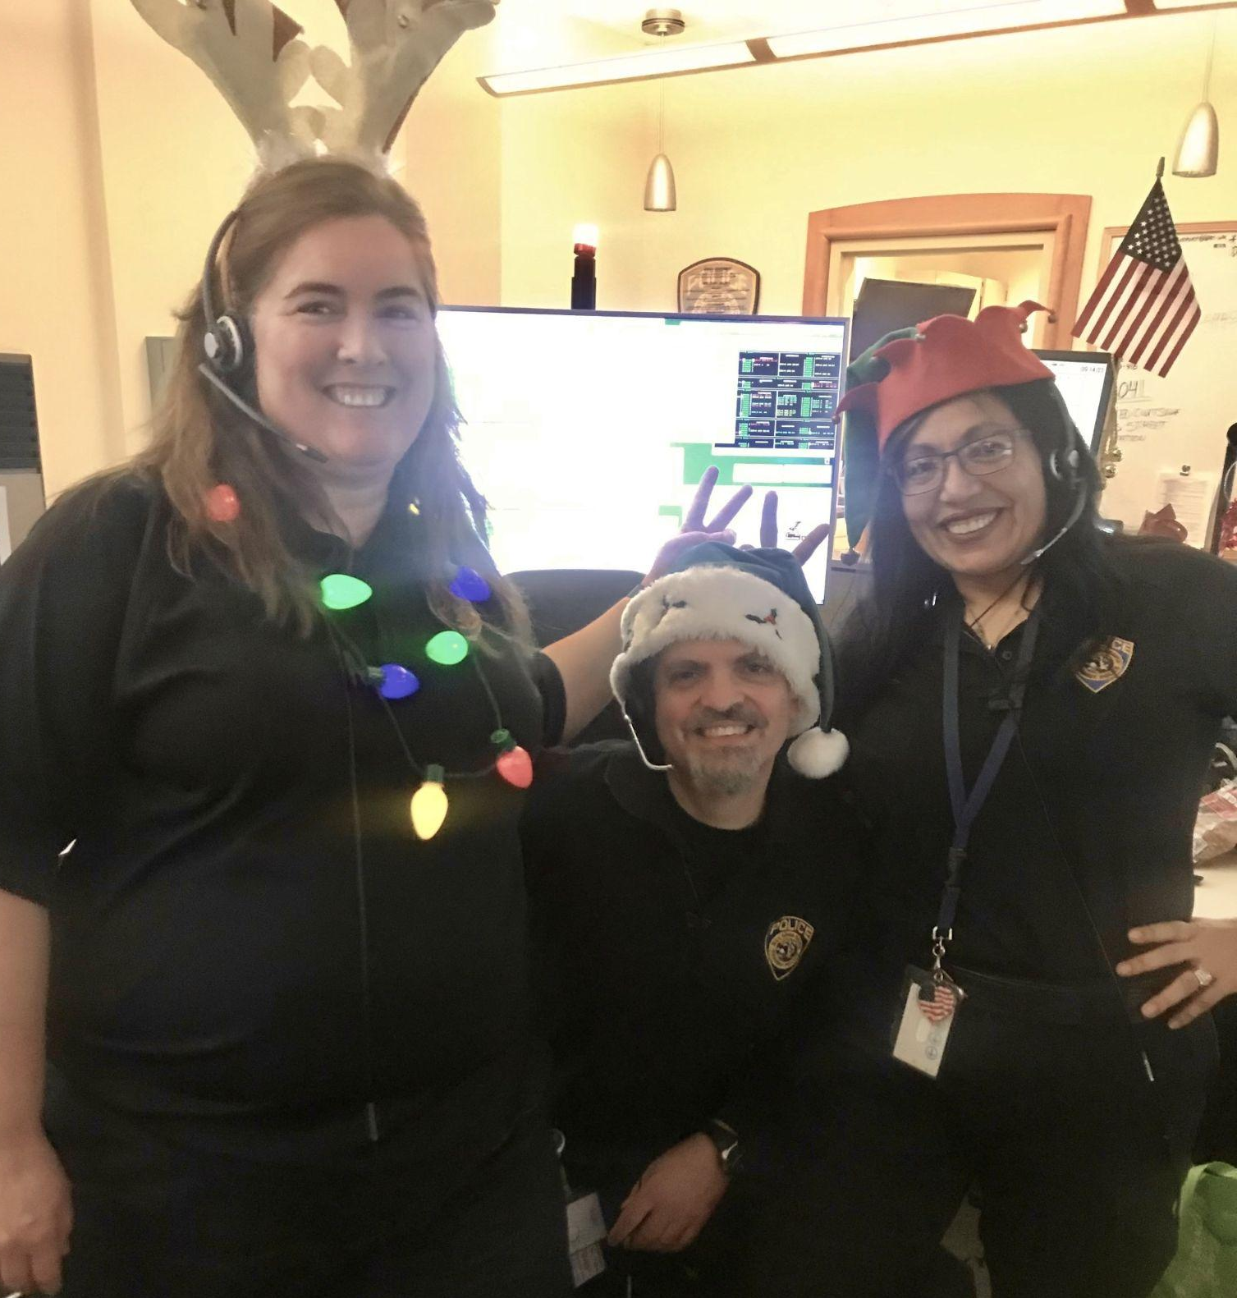
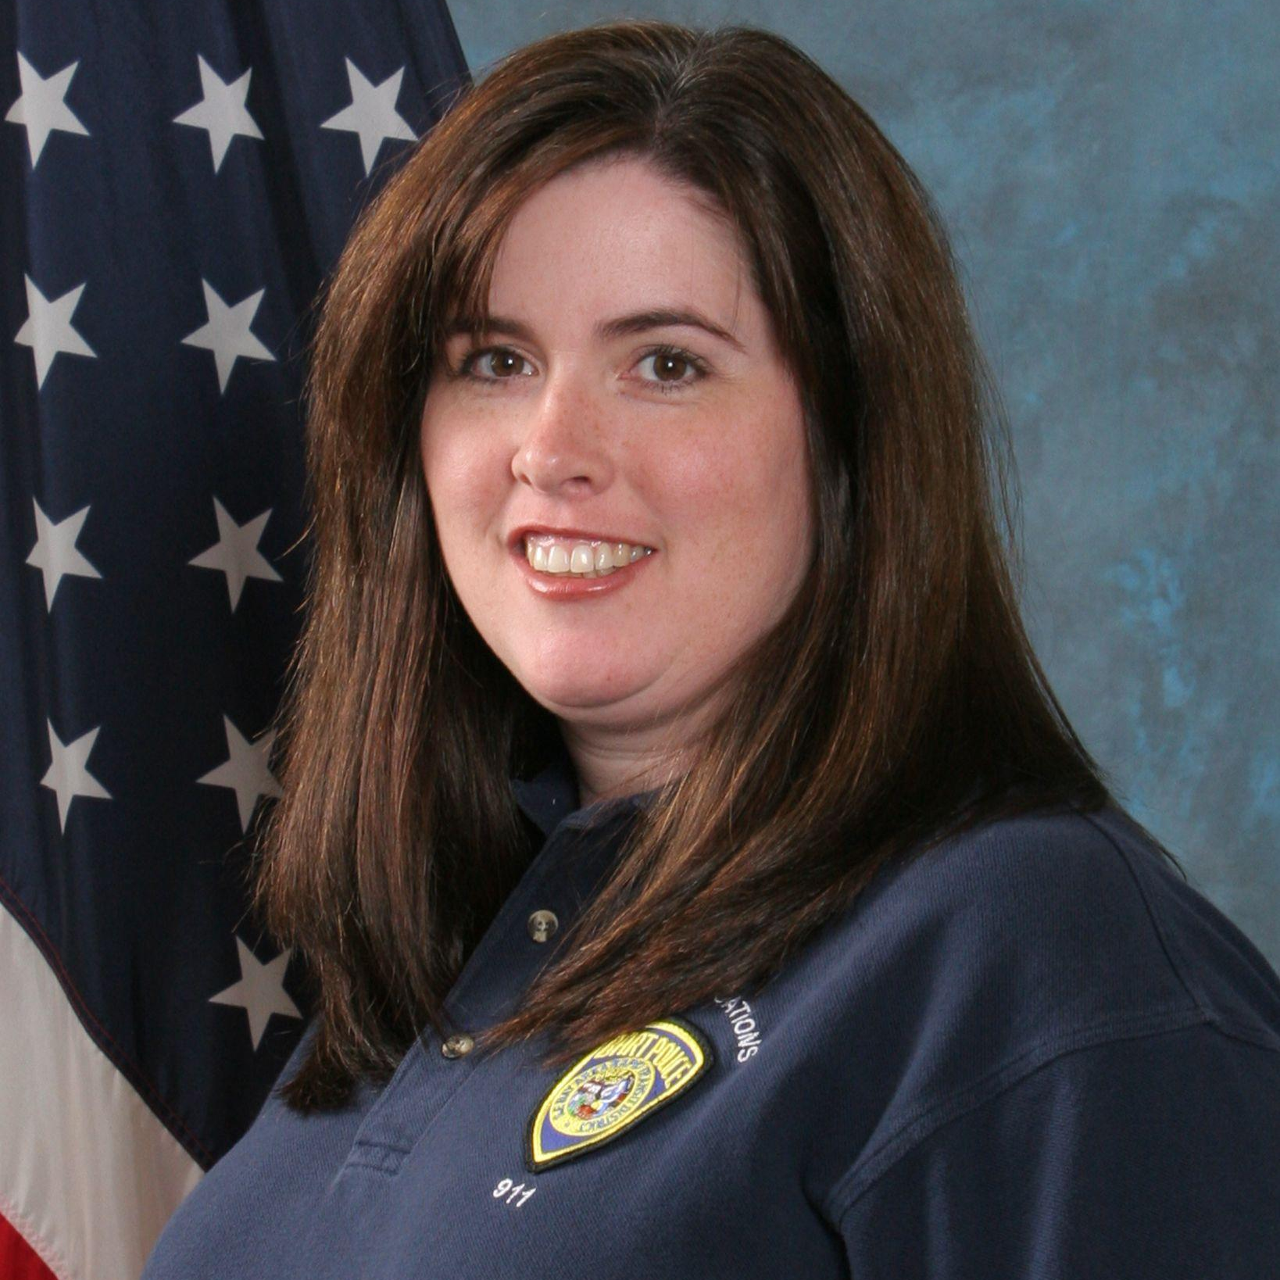
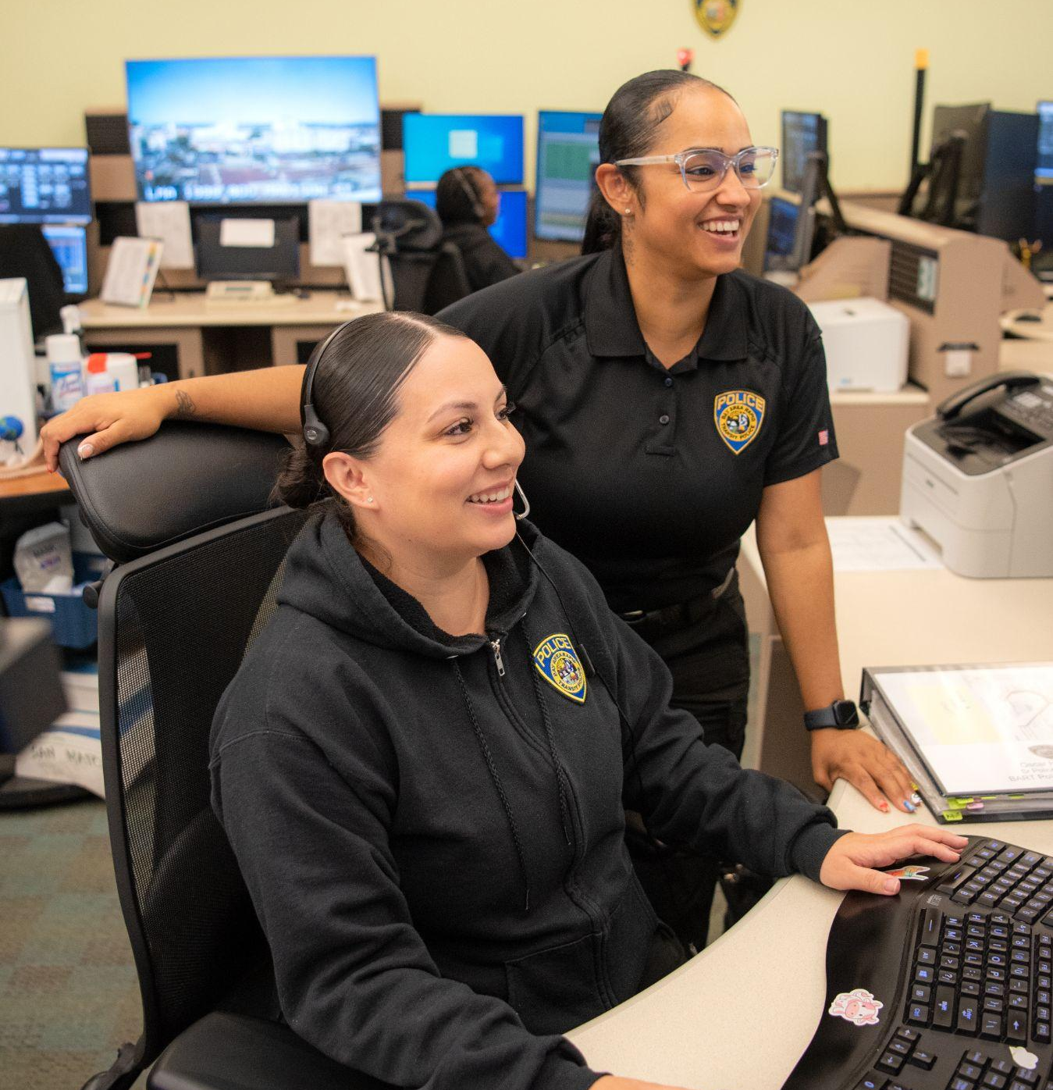
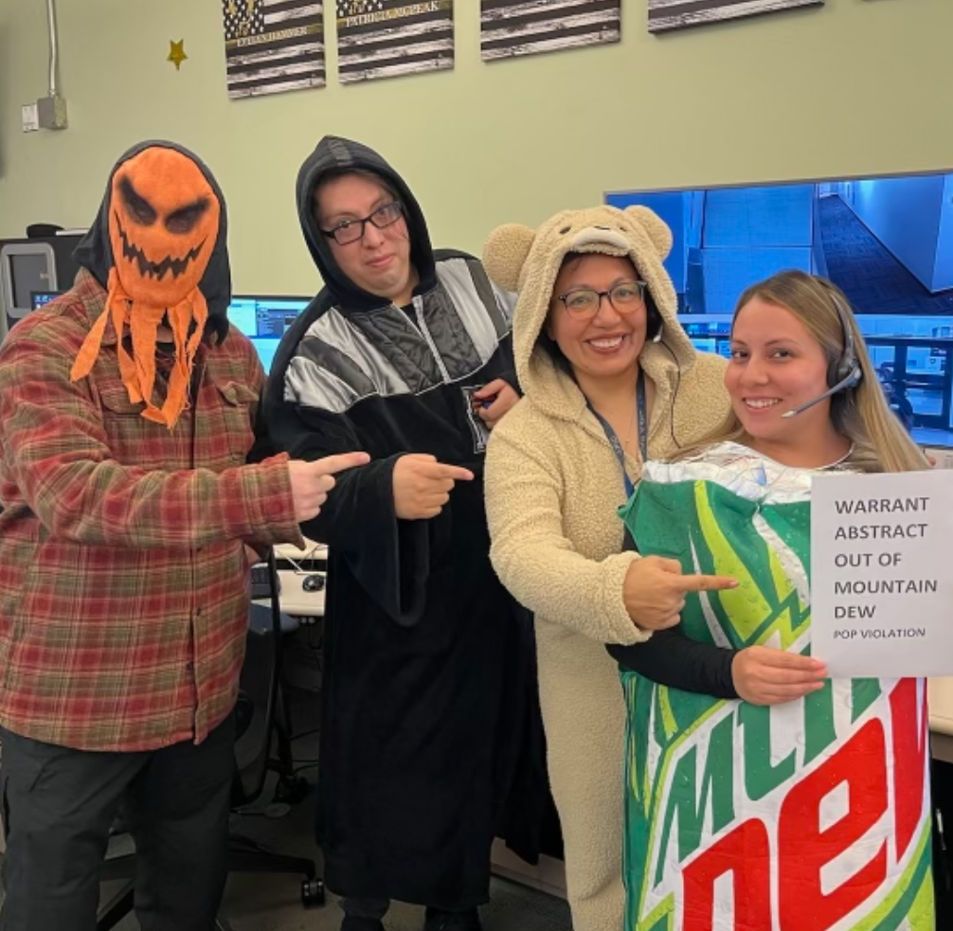
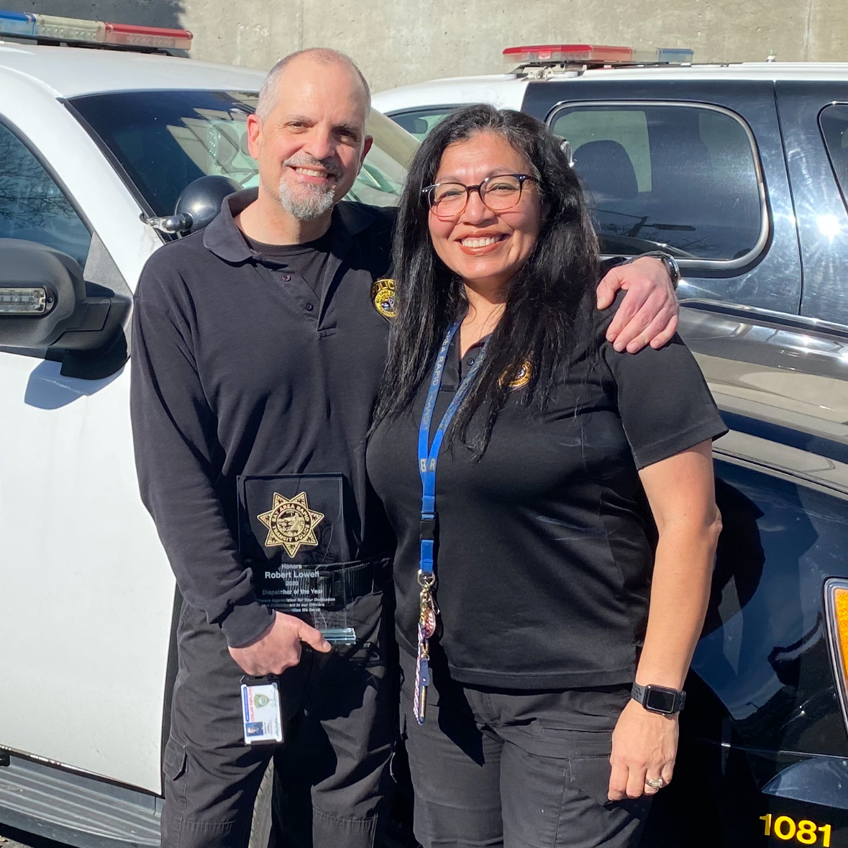
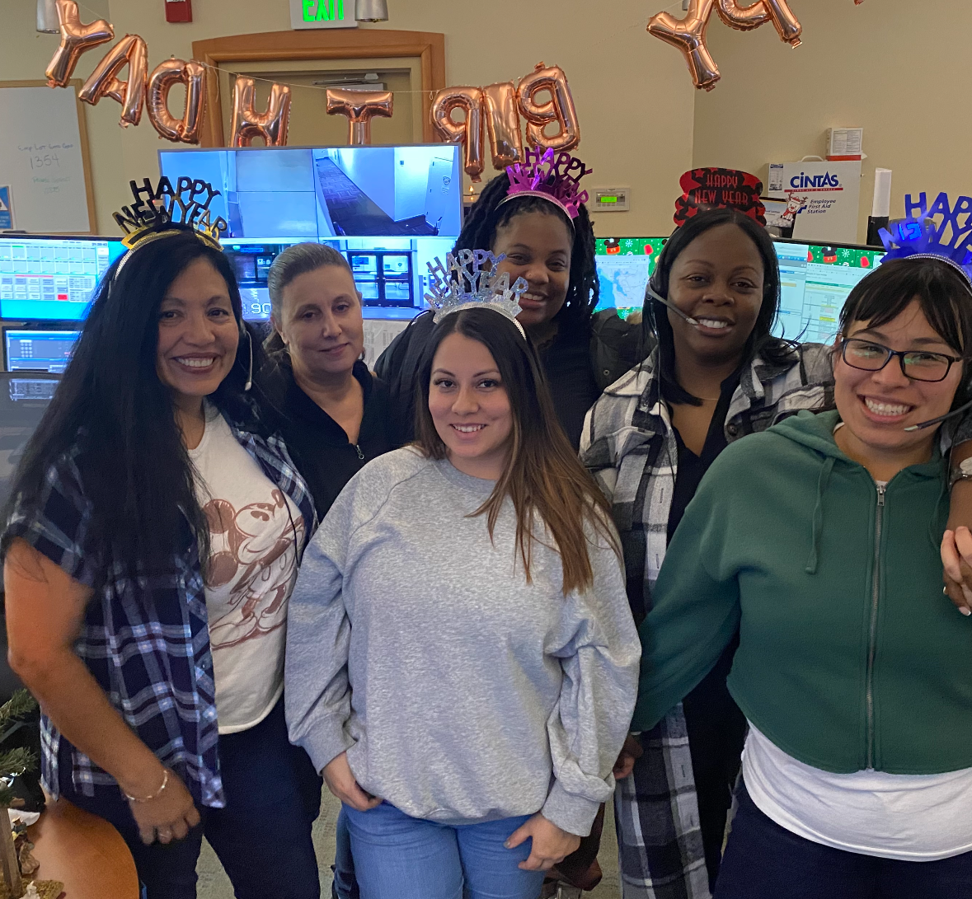
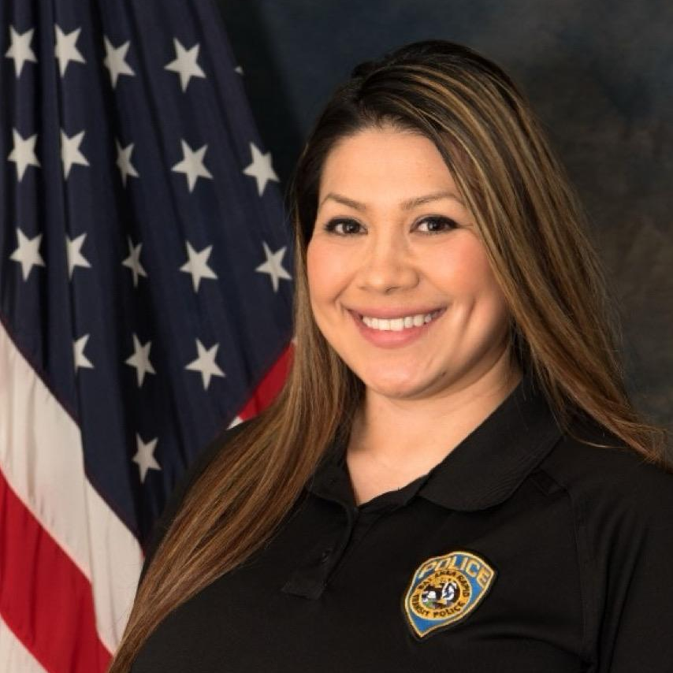
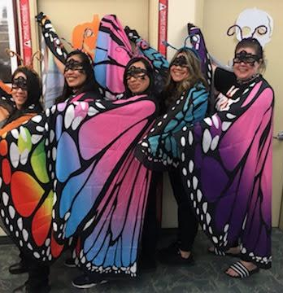
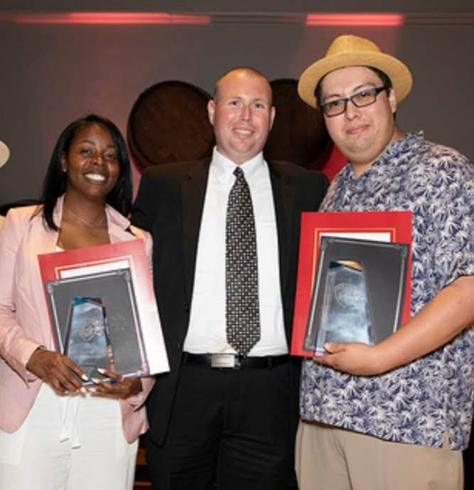
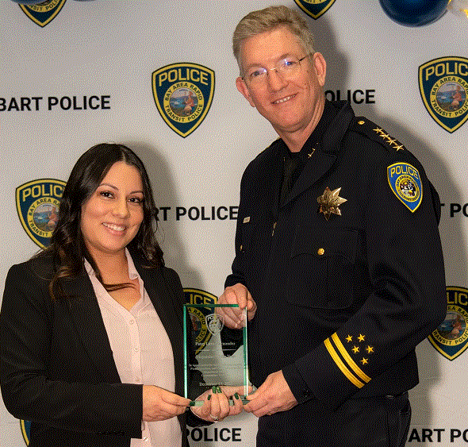
Join our team!
???
?

Slide 10

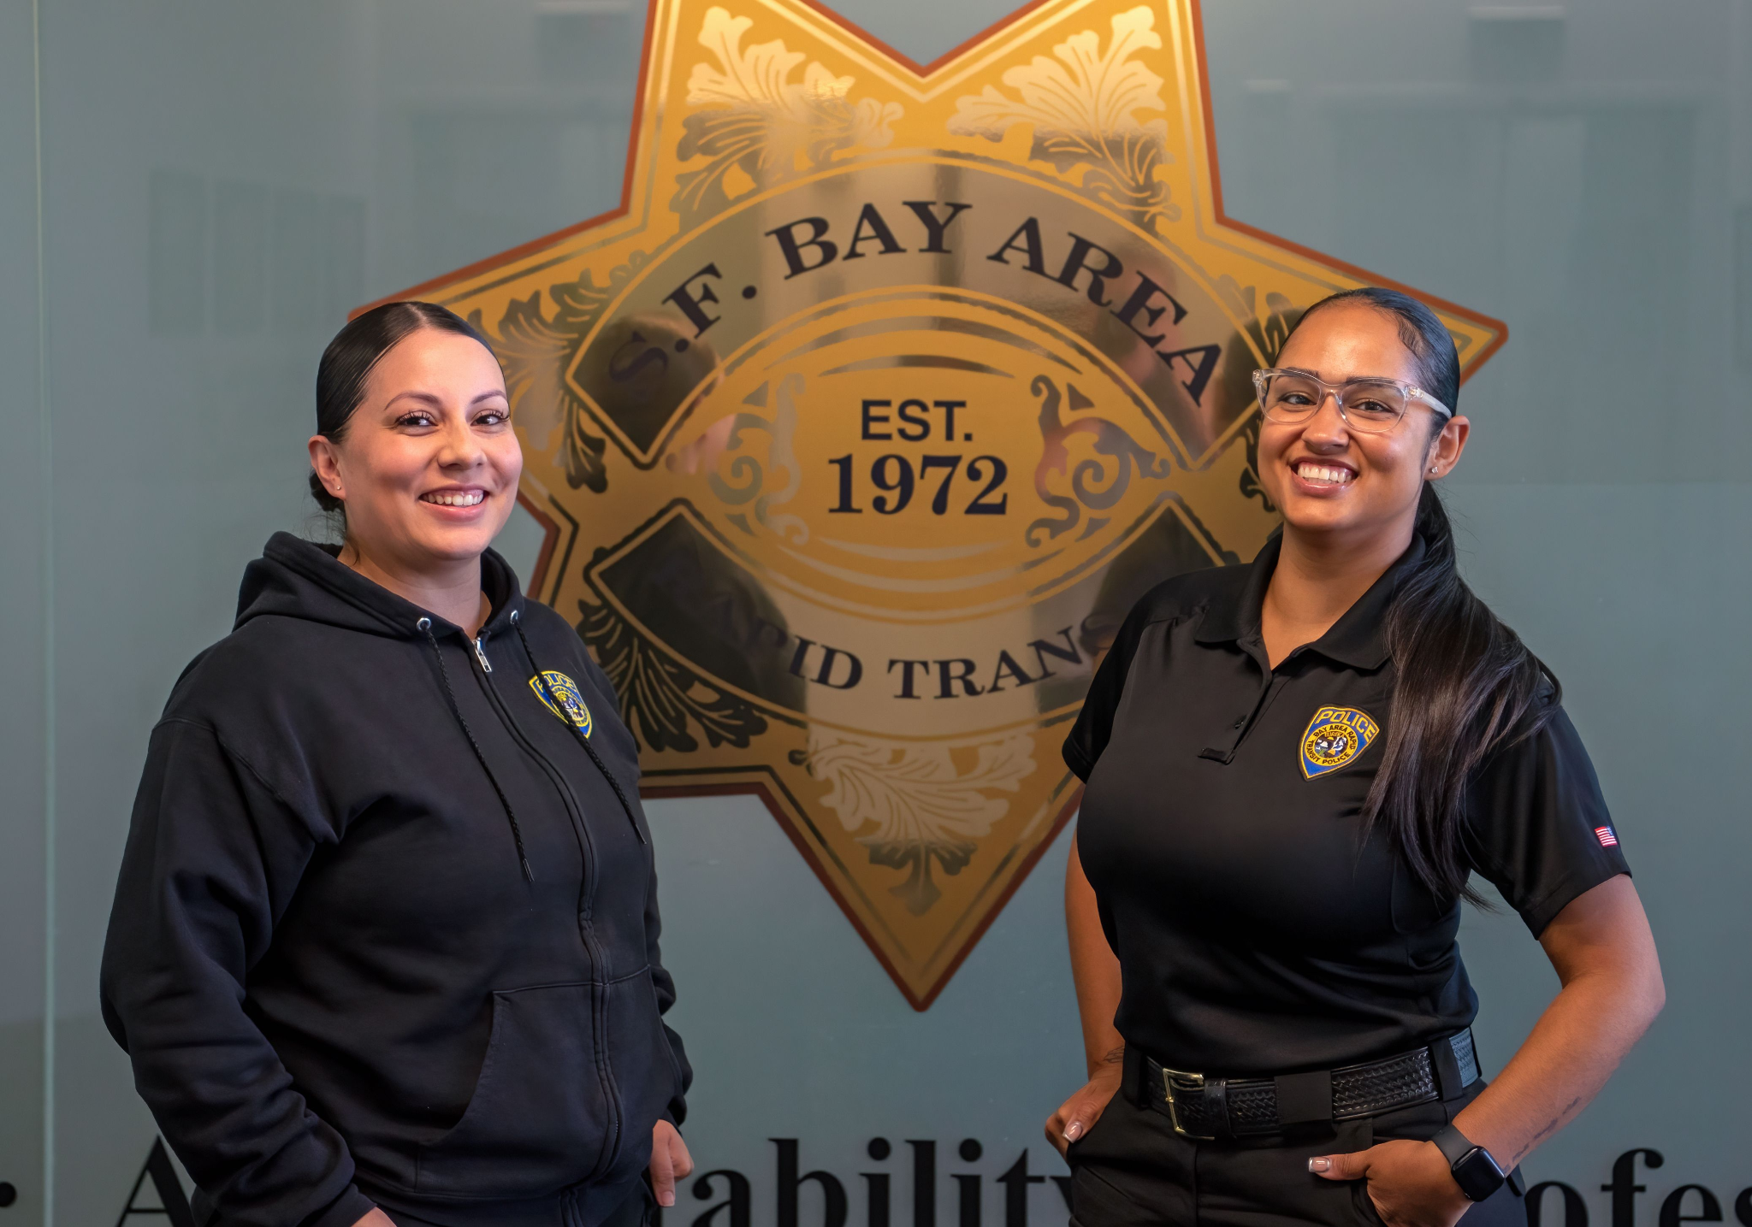

www.joinbartpd.com/police-dispatcher
You could be next!

